Slide 1
Artificial Neural Network

Slide 2
Background
- Neural Networks can be :
- Biological models
- Artificial models
- Desire to produce artificial systems capable of
sophisticated computations similar to the human brain.

Slide 3
Biological analogy and some main ideas
The brain is composed of a mass of interconnected neurons
each neuron is connected to many other neurons
Neurons transmit signals to each other
Whether a signal is transmitted is an all-or-nothing event (the electrical potential in the cell body of the neuron is thresholded)
Whether a signal is sent, depends on the strength of the bond (synapse) between two neurons

Slide 4
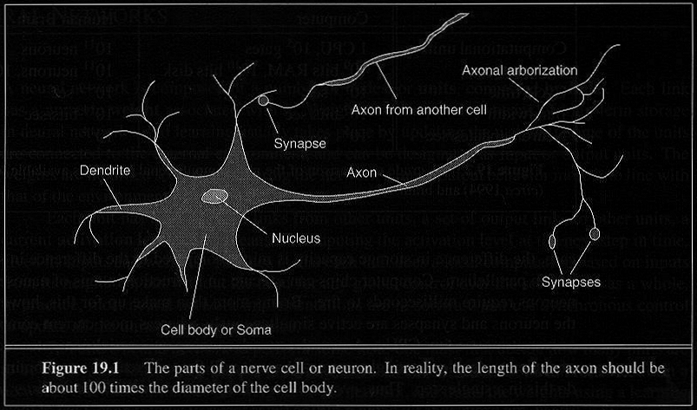
How Does the Brain Work ? (2)
Each consists of :
SOMA, DENDRITES, AXON, and SYNAPSE.

Slide 5
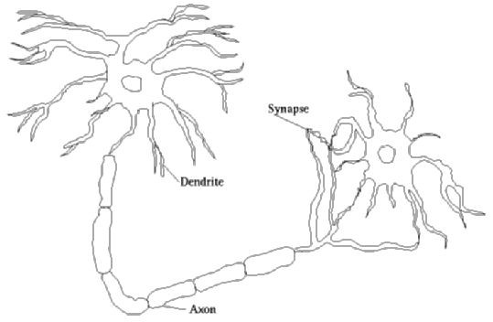
BIOLOGICAL NEURON
Neurons consist of:
(i)
(ii)
(iii)
(iv)
Cell body Dendrites Axon Synapse
Cell body
In Cell body nucleus holds information
Axon emerging from the cell body carry impulses from one neuron to another.
Impulses in a neuron is received by Dendrite.(input)
Information from one neuron flows to another neuron across a synapse.

Slide 6
Brain vs. Digital Computers (1)
Computers require hundreds of cycles to simulate
a firing of a neuron.
- The brain can fire all the neurons in a single step.
Parallelism
- Serial computers require billions of cycles to
perform some tasks but the brain takes less than
a second.
e.g. Face Recognition

Slide 7
Definition of Neural Network
A Neural Network is a system composed of
many simple processing elements operating in
parallel which can acquire, store, and utilize
experiential knowledge.

Slide 8

The basic unit of a neural network is neuron.
A neuron takes inputs, does some math with them, and produces one output.
Input links (dendrites)
Unit (cell body)
Output links (axon)
aj Wji
in_{i} = Σa_{j}W_{ji}
a_{i} = g(in_{i})
a
i

Slide 9
Neurons vs. Units (1)
- Each element of NN is a node called unit.
- Units are connected by links.
- Each link has a numeric weight.

Slide 10
INTRODUCTION
ANN is new Generation of Information Processing Systems, ability to learn, recall, generalization from training data.
Neural networks can learn from data, but cannot be interpreted - they are black boxes to the user.

Slide 11
Simple Computations in this network
- There are 2 types of components: Linear and Non-linear.
- Linear: Input function
- calculate weighted sum of all inputs.
- Non-linear: Activation function
- transform sum into activation level.

Slide 12
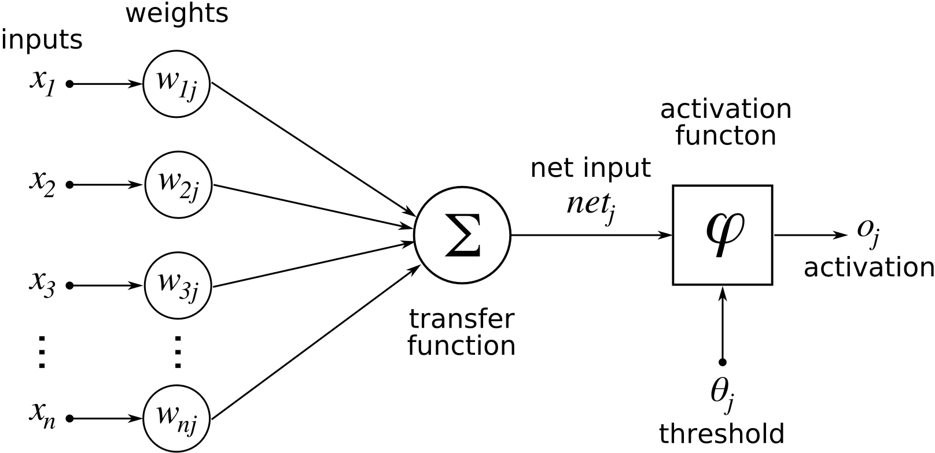

Slide 13
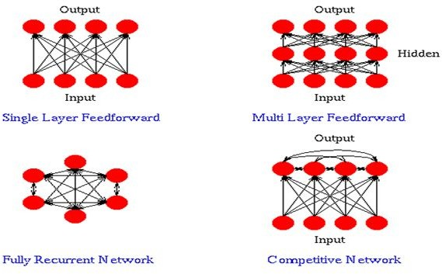

Slide 14
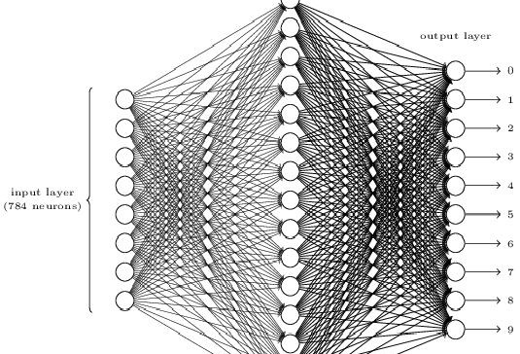

Slide 15
LAYERS
Input Layer: Each input unit holds an attribute value of an instance
Hidden Layer: Not directly observable, provides nonlinearity to the network.
Output Layer: Encodes possible values and provide output for the designated input.

Slide 16
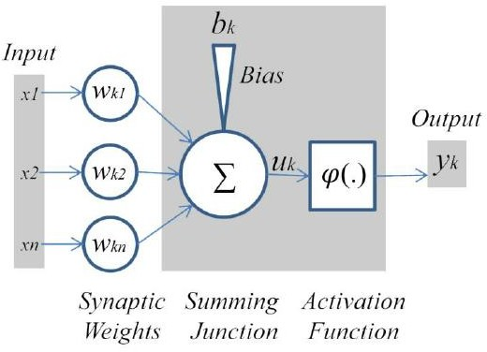
Nonlinear Model of a Neuron

Slide 17
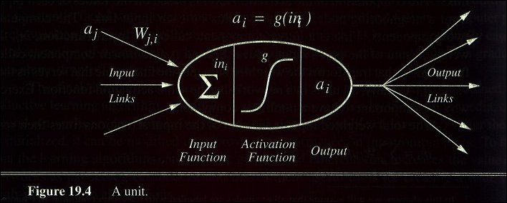
A Computing Unit.
Now in more detail but for a particular model only

Slide 18
Activation Functions
- Use different functions to obtain different models.
- 3 most common choices :
1) Step function
2) Sign function
3) Sigmoid function
- An output of 1 represents firing of a neuron down the axon.

Slide 19
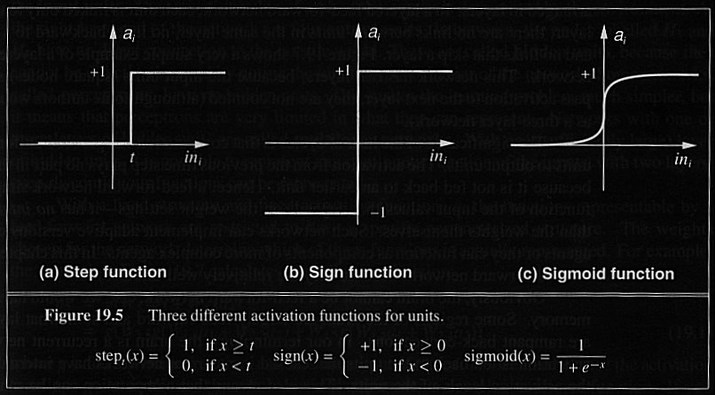
Activation Functions

Slide 20
Feed forward Neural Networks
Multilayer Perceptrons
Deep Feedforward Networks
A feedforward network defines a mapping y = f (x; θ) and learns the value of the parameters θ that result in the best function approximation.
There are no feedback connections in which
outputs of the model are fed back into itself.
When feedforward neural networks are extended to include feedback connections, they are called recurrent neural networks.^{[7]}

Slide 21
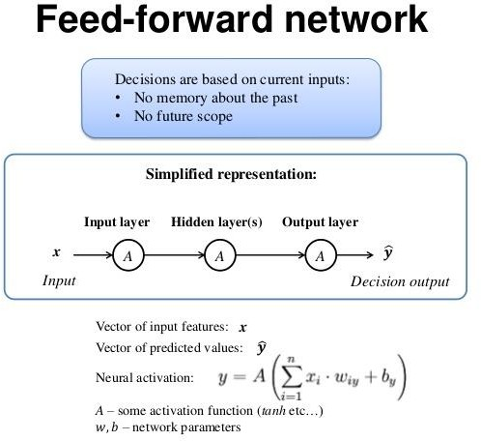
Feed-forward Network

Slide 22
Single layer feed forward NN training
several neurons are arranged in one layer with inputs and weights connect to every neuron.
Learning in such a network occurs by adjusting the weights associated with the inputs so that the network can classify the input patterns.
A single neuron in such a neural network is called perceptron. The algorithm to train a perceptron is stated below.
Let there is a perceptron with (n + 1) inputs x₀, x₁, x₂, · · · , x_{n}
where x₀ = 1 is the bias input.
Let f denotes the transfer function of the neuron. Suppose, X¯ and Y¯ denotes the input-output vectors as a training data set. W¯ denotes the weight matrix.
With this input-output relationship pattern and configuration of a perceptron, the algorithm Training Perceptron to train the perceptron is stated in the following slide.
Soft Computing Applications

Slide 23
Single layer feed forward NN training Algorithm Training Perceptron
Initialize W¯ = w₀, w₁, · · · , w_{n} to some random weights.
2
For each input pattern x ∈ X ¯ do Here, x = {x₀, x₁, ...x_{n}}
Compute I =
∑
n
w_{i} x_{i}
i =0
Compute observed output y
1 , if I > 0
0 , if I ≤ 0
y = f (I) =
Y^{¯0} = Y^{¯0} + y Add y to Y^{¯0}, which is initially empty
If the desired output Y¯ matches the observed output Y^{¯0} then output W¯ and exit.
Otherwise, update the weight matrix W¯ as follows :
3
4
For each output y ∈ Y^{¯0} do
If the observed out y is 1 instead of 0, then w_{i} = w_{i} − αx_{i} ,
(i = 0, 1, 2, · · · n)
Else, if the observed out y is 0 instead of 1, then w_{i} = w_{i} + αx_{i} ,
(i = 0, 1, 2, · · · n)
Go to step 2.
5
Soft Computing Applications

Slide 24
Single layer feed forward NN training
In the above algorithm, α is the learning parameter and is a constant decided by some empirical studies.
Note :
The algorithm Training Perceptron is based on the supervised learning technique
ADALINE : Adaptive Linear Network Element is also an alternative term to perceptron
If there are 10 number of neurons in the single layer feed forward neural network to be trained, then we have to iterate the algorithm for each perceptron in the network.
Soft Computing Applications

Slide 25
Training multilayer feed forward neural network
Like single layer feed forward neural network, supervisory training methodology is
followed to train a multilayer feed forward neural network.
Before going to understand the training of such a neural network,
we redefine some terms involved in it.
A block digram and its configuration for a three layer multilayer FF NN of
type l − m − n is shown in the next slide.
Soft Computing Applications

Slide 26







Specifying a Multi Layer FFNN
_{O}I
_{I}H
_{O}H
_{I}o
O
I
[V]
21
[W]
31
v11
_{I} 1 11
. . . . . .
W j 1
v
1
i1
. . . . . .
v
1i
vl1
I ^{1 1i}
vij v1m
2j
W j k
3 k
i
. . . . . .
vlj
vlm
. . . . . .
_{I} 1 _{1l}
W j n
. . . . . .
.
l
vlm
2m
3n
_{O}I
_{I}H
_{O}H
_{I}o
I
N1
N2
N3
O
[V]
[W]
Input layer
Hidden Layer
Output Layer
|N1|=l
|N2|=m
|N3|=n
Linear transfer function, ɵ
Log-Sigmoid transfer function
Tan-Sigmoid transfer function
f = (I ,α ) =
1
_{e}^{+α}o ^{I}o _{− e}^{−α}o ^{I}o
f = (I ,θ)
m
H
l
f = (I ,α ) =
j j j
−α I ^{H}
n
o
i i i
1+ e
k
k k
+α I −α I
j j
e + e
o o o o
Soft Computing Applications

Slide 27
Specifying a MLFFNN
For simplicity, we assume that all neurons in a particular layer follow same transfer function and different layers follows their respective transfer functions as shown in the configuration.
Let us consider a specific neuron in each layer say i-th, j-th and
k -th neurons in the input, hidden and output layer, respectively.
Also, let us denote the weight between i-th neuron (i = 1, 2, · · · , l)
in input layer to j-th neuron (j = 1, 2, · · · , m) in the hidden layer is
denoted by v_{ij} .
The weight matrix between the input to hidden layer say V is denoted as follows.
v · · ·
· · · v
11 ^{v}12
^{v}1j ^{v}2j
1m
v
· · ·
· · · v
21 ^{v}22
2m
V =
. . . . . .
. . . . . .
^{v}i 1 ^{v}i 2
^{v}l 1 ^{v}l 2
· · ·
· · ·
^{v}ij ^{v}lj
· · ·
· · ·
^{v}im ^{v}lm
Soft Computing Applications

Slide 28
Specifying a MLFFNN
Similarly, w_{jk} represents the connecting weights between j − th
neuron(j = 1, 2, · · · , m) in the hidden layer and k -th neuron
(k = 1, 2, · · · n) in the output layer as follows.
w · · ·
· · · w
11 ^{w}12
21 ^{w}22
^{w}1k ^{w}2k
1n
w
· · ·
· · · w
2n
W =
.
. . . . .
.
. . . . .
^{w}j 1 ^{w}j 2
· · ·
· · ·
^{w}jk ^{w}mk
· · ·
· · ·
^{w}jn
^{w}m1 ^{w}m2
wmn
Soft Computing Applications

Slide 29
Hidden layer computation
Let us consider any j-th neuron in the hidden layer.
Since the output of the input layer’s neurons are the input to the j-th neuron and the j-th neuron follows the log-sigmoid transfer function, we have
O^{H} =
1
H
j _{1+e}−α_{H} ·I_{j}
where j = 1, 2, · · · , m and α_{H} is the constant co-efficient of the transfer function.
Soft Computing Applications

Slide 30
Hidden layer computation
Note that all output of the nodes in the hidden layer can be expressed as a one-dimensional column matrix.
· · ·
· .· ·
.
1
O^{H} =
_{1+e}−α_{H} ·I_{j}
H
.
.
· · ·
· · ·
m×1
Soft Computing Applications

Slide 31
Output layer computation
Let us calculate the input to any k-th node in the output layer. Since, output of all nodes in the hidden layer go to the k-th layer with weights w_{1k} , w_{2k} , · · · , w_{mk} , we have
O H
H
H
I = w
· o + w
· o + · · · + w
· o
k 1
1k 2k
2
mk
m
where k = 1, 2, · · · , n
In the matrix representation, we have
I^{O} = W^{T} · O^{H}
[n × 1] = [n × m] [m × 1]
Soft Computing Applications

Slide 32
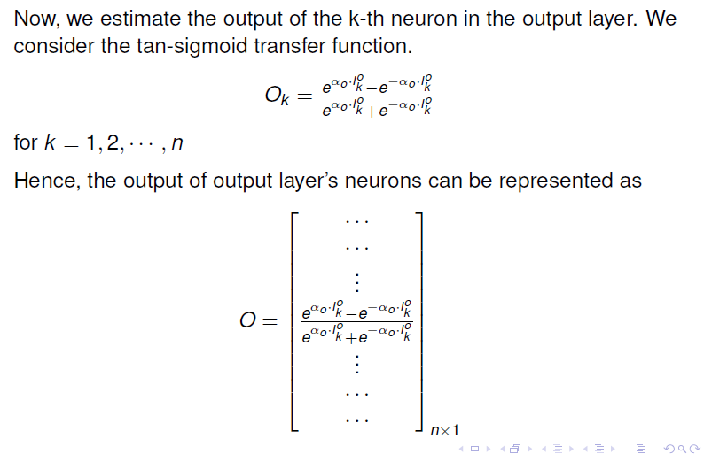
Output Layer Computation
28

Slide 33
Output layer computation
Now, we estimate the output of the k-th neuron in the output layer. We consider the tan-sigmoid transfer function.
₌ e k −e
o
αo·Iº −α ·I
O
o
k
k
o
o
α ·I −α ·I
o
o
e k +e
k
for k = 1, 2, · · · , n
Hence, the output of output layer’s neurons can be represented as
 
 
· · ·
· .· ·
 
.

o o

α ·I −α ·I
o o
O =
e k −e
k

o
o
α ·I −α ·I
k 
o
o
e k +e
.

.
· · ·
· · ·



n×1
Soft Computing Applications

Slide 34
Back Propagation Algorithm
The above discussion comprises how to calculate values of different parameters in l − m − n multiple layer feed forward neural network.
Next, we will discuss how to train such a neural network.
We consider the most popular algorithm called Back-Propagation algorithm, which is a supervised learning.
The principle of the Back-Propagation algorithm is based on the error-correction with Steepest-descent method.
We first discuss the method of steepest descent followed by its use in the training algorithm.
Soft Computing Applications

Slide 35
Method of Steepest Descent
Supervised learning is, in fact, error-based learning.
In other words, with reference to an external signal (i.e. target output) it calculates error by comparing the target output and computed output.
Based on the error signal, the neural network should modify its configuration, which includes synaptic connections, that is , the weight matrices.
It should try to reach to a state, which yields minimum error.
In other words, its searches for a suitable values of parameters minimizing error, given a training set.
Note that, this problem turns out to be an optimization problem.
Soft Computing Applications

Slide 36
Method of Steepest Descent
E
Error, E
V
Initial weights
V, W
Adjusted weight
W
Best weight
(b) Error surface with two parameters V and W
(a) Searching for a minimum error
Soft Computing Applications

Slide 37
Method of Steepest Descent
For simplicity, let us consider the connecting weights are the only design parameter.
Suppose, V and W are the wights parameters to hidden and output layers, respectively.
Thus, given a training set of size N, the error surface, E can be represented as
E =
Σ
N
i =1
e^{i} (V, W, I_{i} )
where I_{i} is the i-th input pattern in the training set and e^{i} (...)
denotes the error computation of the i-th input.
Now, we will discuss the steepest descent method of computing error, given a changes in V and W matrices.
Soft Computing Applications

Slide 38
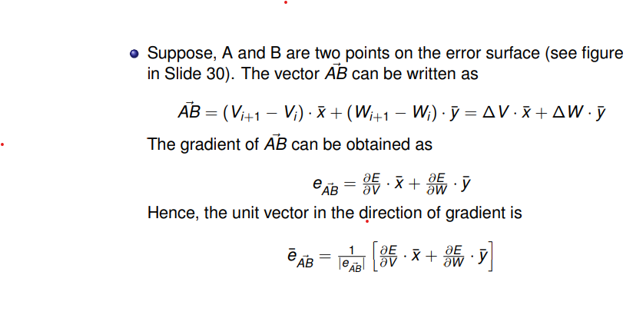
Method of Steepest Descent
Soft Computing Applications

Slide 39
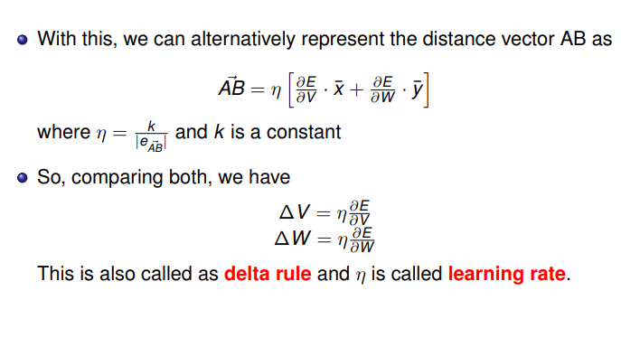
Method of Steepest Descent
Soft Computing Applications

Slide 40
Calculation of error in a neural network
Let us consider any k-th neuron at the output layer. For an input pattern I_{i} ∈ T_{I} (input in training) the target output T_{Ok} of the k-th neuron be T_{Ok} .
Then, the error e_{k} of the k-th neuron is defined corresponding to the input I_{i} as
e = (T
1 2
k
— O )
2
Ok Ok
where O_{Ok} denotes the observed output of the k-th neuron.
Soft Computing Applications

